Slide 1
Road Signs and Markings
Recognition
Quiz

Slide 2
Each sign will appear for 0.3 seconds…

Slide 3
You will then have ten (10) seconds to write down its meaning on your paper.

Slide 4
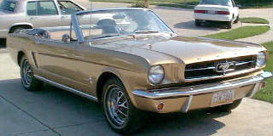
Ready to Roll?

Slide 5
Here Comes
Sign # 1. . .

Slide 6

1

Slide 7
Here Comes
Sign # 2. . .

Slide 8

2

Slide 9
Here Comes
Sign # 3. . .

Slide 10

3

Slide 11
Here Comes
Sign # 4. . .

Slide 12

4

Slide 13
Here Comes
Sign # 5. . .

Slide 14
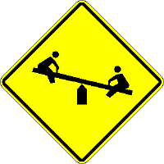
5

Slide 15
Here Comes
Sign # 6. . .

Slide 16

6

Slide 17
Here Comes
Sign # 7. . .

Slide 18

7

Slide 19
Here Comes
Sign # 8. . .

Slide 20

8

Slide 21
Here Comes
Sign # 9. . .

Slide 22

9

Slide 23
Here Comes
Sign # 10. . .

Slide 24

10

Slide 25
Here Comes
Sign #11. . .

Slide 26

11

Slide 27
Here Comes
Sign #12. . .

Slide 28

12

Slide 29
Here Comes
Sign #13. . .

Slide 30

13

Slide 31
Here Comes
Sign #14. . .

Slide 32

14

Slide 33
Here Comes
Sign #15. . .

Slide 34

15

Slide 35
What do the DIAMOND SHAPED ROAD MARKINGS in this next slide signify?

Slide 36
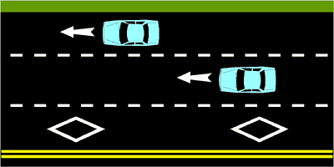
16

Slide 37
Here Comes
Sign #17. . .

Slide 38
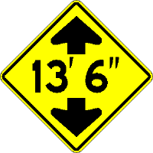
17

Slide 39
Here Comes
Sign #18. . .

Slide 40

18

Slide 41
Here Comes
Sign #19. . .

Slide 42

19

Slide 43
Here Comes
Sign #20. . .

Slide 44

20

Slide 45
Here Comes
Sign #21. . .

Slide 46

21

Slide 47
Here Comes
Sign #22. . .

Slide 48

22

Slide 49
Here Comes
Sign #23. . .

Slide 50

23

Slide 51
Here Comes
Sign #24. . .

Slide 52

24

Slide 53
Here Comes
Sign #25. . .

Slide 54

25

Slide 55
Here Comes
Sign #26. . .

Slide 56

26

Slide 57
Here Comes
Sign #27. . .

Slide 58

27

Slide 59
Here Comes
Sign #28. . .

Slide 60

28

Slide 61
Here Comes
Sign #29. . .

Slide 62
29

Slide 63
Here Comes
Sign #30. . .

Slide 64

30

Slide 65
Here Comes
Sign #31. . .

Slide 66

31

Slide 67
Here Comes
Sign #32. . .

Slide 68

32

Slide 69
Here Comes
Sign #33. . .

Slide 70

33

Slide 71
Here Comes
Sign #34. . .

Slide 72
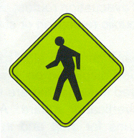
34

Slide 73
Here Comes
Sign #35. . .

Slide 74

35

Slide 75
Here Comes
Sign #36. . .

Slide 76

36

Slide 77
Here Comes
Sign #37. . .

Slide 78

37

Slide 79
Here Comes
Sign #38. . .

Slide 80

38

Slide 81
Here Comes
Sign #39. . .

Slide 82

39

Slide 83
Here Comes
Sign #40. . .

Slide 84

40

Slide 85
Here Comes
Sign #41. . .

Slide 86

41

Slide 87
Here Comes
Sign #42. . .

Slide 88
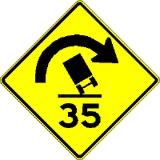
42

Slide 89
Here Comes
Sign #43. . .

Slide 90

43

Slide 91
Here Comes
Sign #44. . .

Slide 92
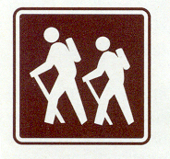
44

Slide 93
Here Comes
Sign #45. . .

Slide 94

45

Slide 95
Here Comes
Sign #46. . .

Slide 96

46

Slide 97
Here Comes
Sign #47. . .

Slide 98

47

Slide 99
Here Comes
Sign #48. . .

Slide 100

48

Slide 101
Here Comes Sign #49. . .

Slide 102

49

Slide 103
Here Comes
Sign #50. . .

Slide 104

50

Slide 105
That’s All Folks!!!!

Slide 106

ANSWERS….

Slide 107
ANSWERS….
No Right Turn at the Intersection
Warning of Multiple Curves Ahead
Warning of Stop Sign at Intersection
Warning of Two-Way Traffic Ahead
Warning of Playground Ahead
Do Not Enter This Roadway

Slide 108
ANSWERS…
Warning of Intersection Ahead
Warning of Steep Downgrade..Downshift Needed
Warning of Wildlife Crossing..Elk Crossing
Warning of Divided Highway Starting Ahead
Regulation.. No Parking Area
Warning of Divided Highway Ending Ahead

Slide 109
ANSWERS…
Warning of Flagman Ahead
Regulation… Yield to Traffic at Next Intersection
Information… Hospital Zone or Location
16. Diamond Indicates High Occupancy Vehicle Lane
Warning of Restricted Height Space Ahead
Information… Information Center Location

Slide 110
ANSWERS…
Warning of Right Lane Ending Ahead
Regulation… Move to the Right into the Lane
Warning of Merging Traffic from the Right
Regulation… No Bicyclists on this Roadway
Warning… Uneven or Low Shoulder Ahead
Warning of Left Lane Ending Ahead

Slide 111
ANSWERS…
Warning of Traffic Signal at Next Intersection
Warning of T-intersection to the Right
No Pedestrians In This Area
Warning of School Zone Ahead
Warning of School Crosswalk
Regulation… One Way Street This Direction

Slide 112
ANSWERS…
Warning of Railroad Crossing Near Intersection Ahead
No Delivery Trucks in This Roadway or Area
Junction of Roadways As Listed
Warning of Pedestrian Crossings Ahead
Warning of Construction Zone Ahead
Regulation… No U-turn Permitted

Slide 113
ANSWERS…
Warning of Slow Moving Vehicle Ahead
Warning of Lane Added to Left Side of Roadway
Regulation… Dual Right Turns Allowed Within Lanes
Warning of Sharp Curves Ahead to Left and Right
All Traffic Flow Moves to the Left Here
Warning of Sharp Curve Ahead With Less than Normal Roadway Banking

Slide 114
ANSWERS…
Information… Airport Ahead
Recreational… Hiking Trail Ahead
Warning of Narrow Roadway with Bridge Abutments
Regulation… Towing Zone, Do Not Park In This Area
Regulation… No Hitchhiking in This Area

Slide 115
ANSWERS…
Information… Boat Loading/Unloading Docks Ahead
Warning of Roadway Pavement Ending, Changes from Paved Roadway to Gravel Roadway
Warning of Pedestrians Crossing Freeway (California Special, may also be used to warn of playgrounds)

